Slide 1


 | Dothan Gun Club – Steel Challenge Match
START POSITION : Standing in shooting box.
GUN READY CONDITIONS : Centerfire pistol: gun loaded, holstered, wrists above respective shoulders. Rimfire pistol, rimfire rifle, and PCC: gun loaded and aimed at orange cone/aiming point. |  | SCORING: 5 strings of 5 hits per stage. Worst string in each stage is discarded. TARGETS: 5 Steel SCORED HITS: Hit anywhere on face of steel START-STOP: Audible, hit on stop plate or 30 seconds per string RULES: Each miss per string adds 3 seconds to that string’s time. Hitting the stop plate first in a string makes the time for that string 30 seconds.
STAGE PROCEDURE: Engage each steel with one hit then engage the stop plate with one hit.
P1
X
X

Slide 2
 | Dothan Gun Club – Steel Challenge Match
START POSITION : Standing in shooting box.
GUN READY CONDITIONS : Centerfire pistol: gun loaded, holstered, wrists above respective shoulders. Rimfire pistol, rimfire rifle, and PCC: gun loaded and aimed at orange cone/aiming point. |  | SCORING: 5 strings of 5 hits per stage. Worst string in each stage is discarded. TARGETS: 5 Steel SCORED HITS: Hit anywhere on face of steel START-STOP: Audible, hit on stop plate or 30 seconds per string RULES: Each miss per string adds 3 seconds to that string’s time. Hitting the stop plate first in a string makes the time for that string 30 seconds.
STAGE PROCEDURE: Engage each steel with one hit then engage the stop plate with one hit.
P1
X
X

Slide 3
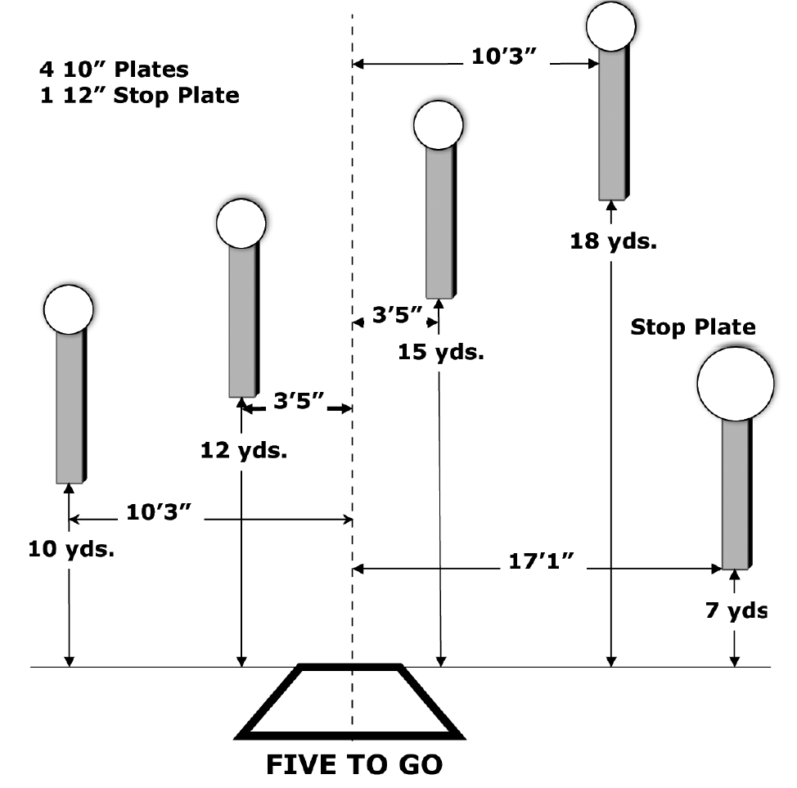
 | Dothan Gun Club – Steel Challenge Match Five to Go
START POSITION : Standing in shooting box.
GUN READY CONDITIONS : Centerfire pistol: gun loaded, holstered, wrists above respective shoulders. Rimfire pistol, rimfire rifle, and PCC: gun loaded and aimed at orange cone/aiming point. |  | SCORING: 5 strings of 5 hits per stage. Worst string in each stage is discarded. TARGETS: 5 Steel SCORED HITS: Hit anywhere on face of steel START-STOP: Audible, hit on stop plate or 30 seconds per string RULES: Each miss per string adds 3 seconds to that string’s time. Hitting the stop plate first in a string makes the time for that string 30 seconds.
STAGE PROCEDURE: Engage each steel with one hit then engage the stop plate with one hit.
P1
X
X

Slide 4
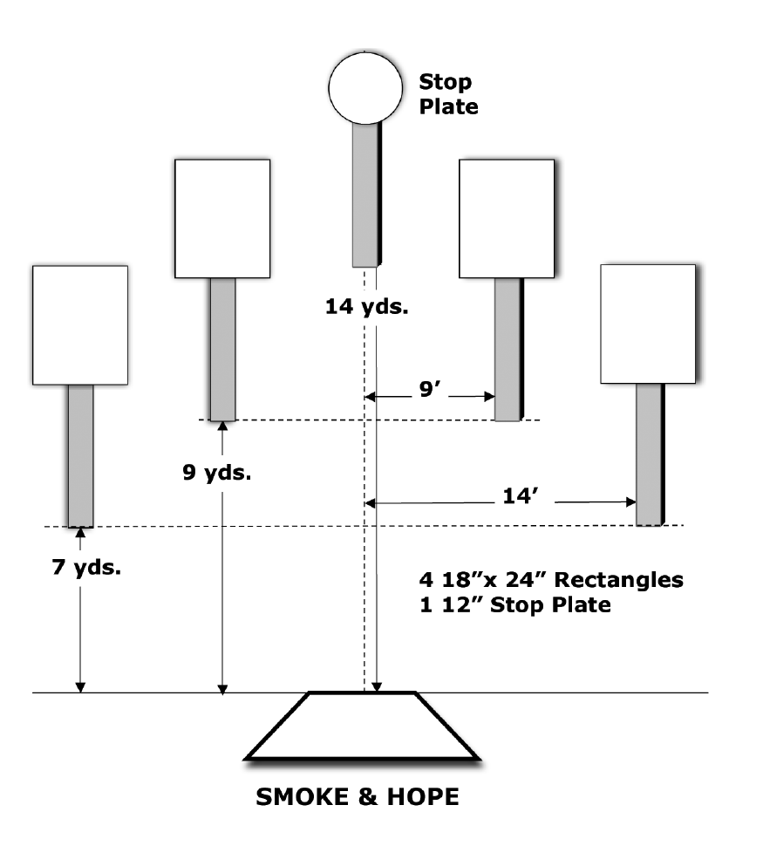
 | Dothan Gun Club – Steel Challenge Match Smoke and Hope
START POSITION : Standing in shooting box.
GUN READY CONDITIONS : Centerfire pistol: gun loaded, holstered, wrists above respective shoulders. Rimfire pistol, rimfire rifle, and PCC: gun loaded and aimed at orange cone/aiming point. |  | SCORING: 5 strings of 5 hits per stage. Worst string in each stage is discarded. TARGETS: 5 Steel SCORED HITS: Hit anywhere on face of steel START-STOP: Audible, hit on stop plate or 30 seconds per string RULES: Each miss per string adds 3 seconds to that string’s time. Hitting the stop plate first in a string makes the time for that string 30 seconds.
STAGE PROCEDURE: Engage each steel with one hit then engage the stop plate with one hit.
P1
X
X

Slide 5
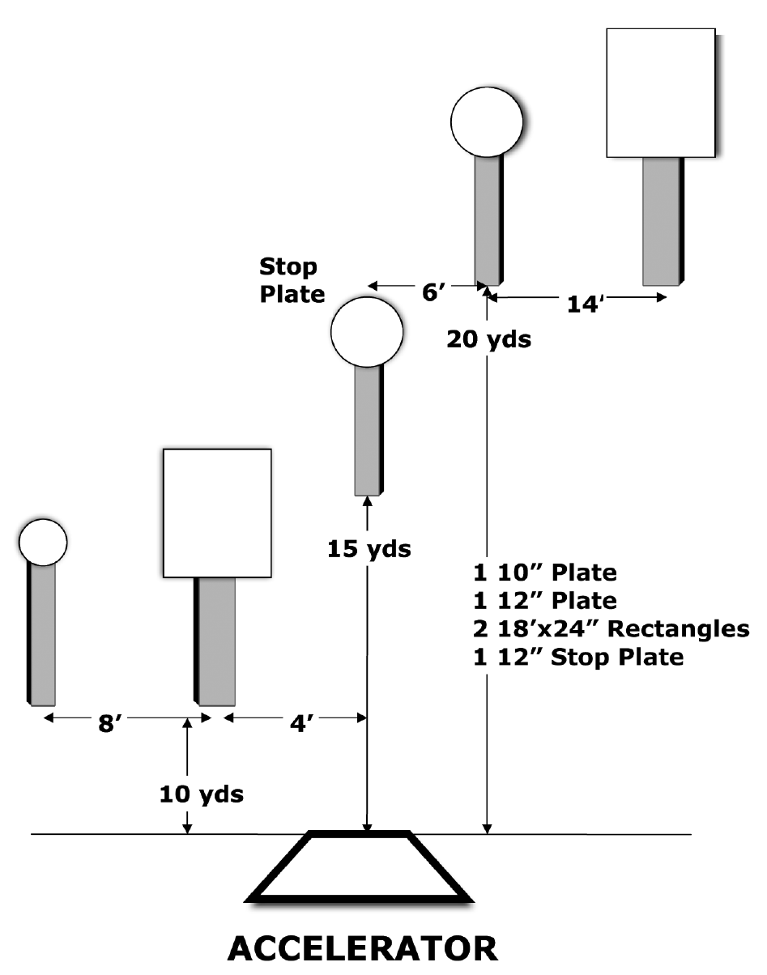
 | Dothan Gun Club – Steel Challenge Match Accelerator
START POSITION : Standing in shooting box.
GUN READY CONDITIONS : Centerfire pistol: gun loaded, holstered, wrists above respective shoulders. Rimfire pistol, rimfire rifle, and PCC: gun loaded and aimed at orange cone/aiming point. |  | SCORING: 5 strings of 5 hits per stage. Worst string in each stage is discarded. TARGETS: 5 Steel SCORED HITS: Hit anywhere on face of steel START-STOP: Audible, hit on stop plate or 30 seconds per string RULES: Each miss per string adds 3 seconds to that string’s time. Hitting the stop plate first in a string makes the time for that string 30 seconds.
STAGE PROCEDURE: Engage each steel with one hit then engage the stop plate with one hit.
P1
X
X

Slide 6
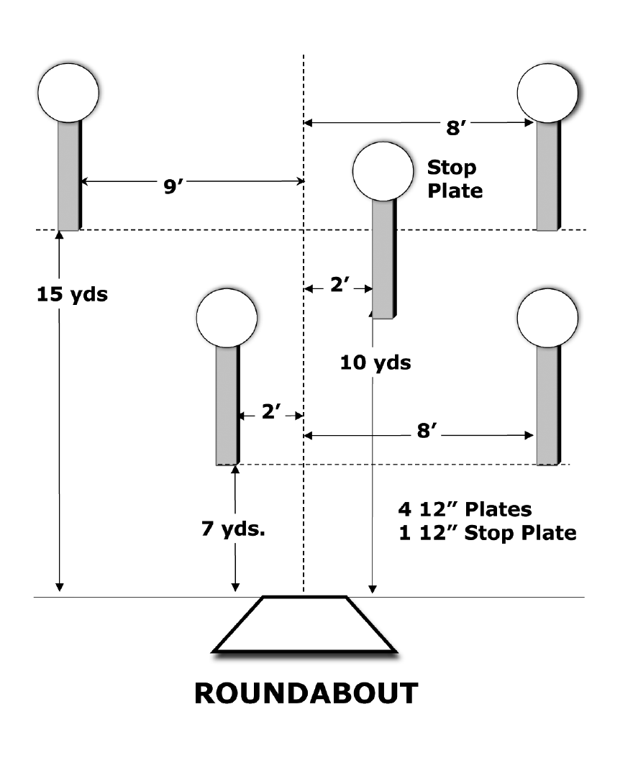
 | Dothan Gun Club – Steel Challenge Match Roundabout
START POSITION : Standing in shooting box.
GUN READY CONDITIONS : Centerfire pistol: gun loaded, holstered, wrists above respective shoulders. Rimfire pistol, rimfire rifle, and PCC: gun loaded and aimed at orange cone/aiming point. |  | SCORING: 5 strings of 5 hits per stage. Worst string in each stage is discarded. TARGETS: 5 Steel SCORED HITS: Hit anywhere on face of steel START-STOP: Audible, hit on stop plate or 30 seconds per string RULES: Each miss per string adds 3 seconds to that string’s time. Hitting the stop plate first in a string makes the time for that string 30 seconds.
STAGE PROCEDURE: Engage each steel with one hit then engage the stop plate with one hit.
P1
X
X

